Slide 1
Children in Transition
Tori Vohland
McKinney-Vento Homeless Liaison
10/28/2024

Slide 2
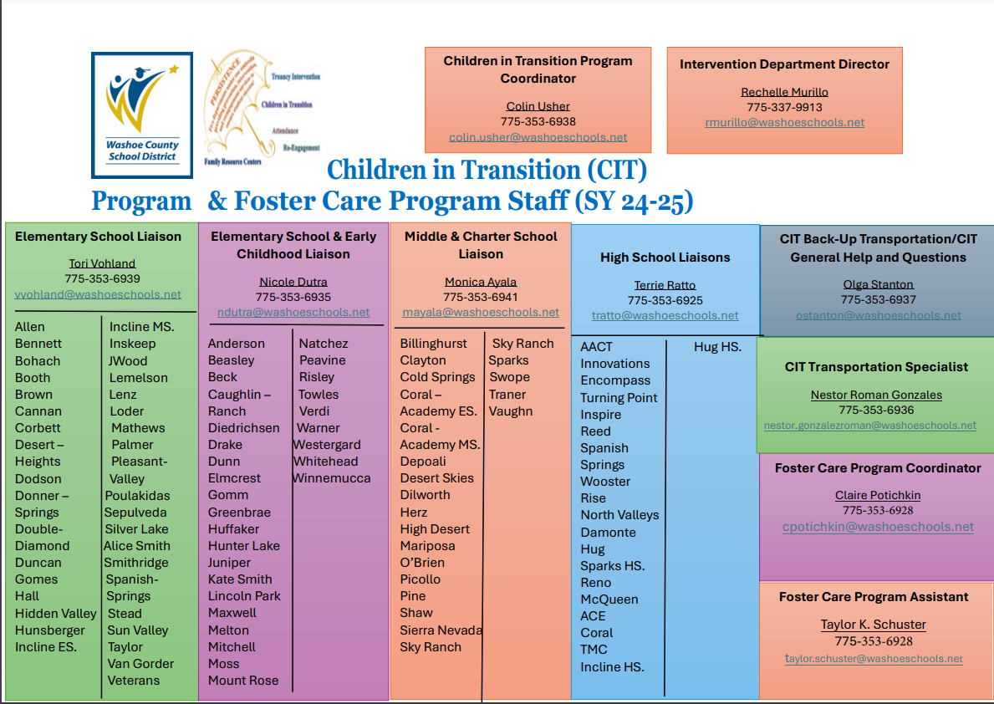
WCSD
Intervention Department
Children in Transition
Notes:
MV- established in 1987.

Slide 3
McKinney-Vento Assistance Act
42 U.S.C. §11434
Federal law that requires equal educational access, attendance, services, and success for children and youth experiencing homelessness as defined by law.
Defines homelessness as individuals who lack a fixed, regular, or adequate nighttime residence.
Requires SEAs to designate an Office of State Coordinator that can sufficiently carry out duties in the Act. 42 U.S.C. §11434a(2)
Requires LEAs to designate a liaison(s) for students experiencing homelessness who can carry out the duties described in the law 42 U.S.C. §11432(g)(1)(J)(ii).
.
Notes:
MV- established in 1987.

Slide 4
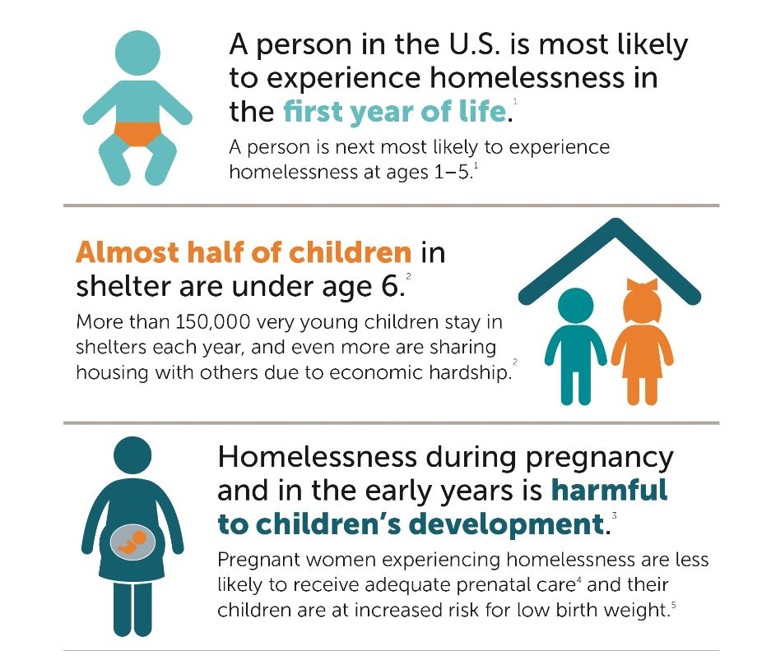
McKinney-Vento and Early Childhood
The McKinney-Vento Act applies to federally funded preschools. This means children 0-5 experiencing homelessness have the same rights and can enroll immediately in preschools without the typically required documents (if space is available); continue attending their preschool even if they move out of the attendance area; and receive transportation to preschool.

Slide 5
Federal Guidance and Early Childhood Education
State McKinney-Vento plans must include procedures that ensure that children experiencing homelessness have access to public preschool programs administered by the SEA or LEA.
Designated Local Liaisons must ensure access to Head Start, early intervention (IDEA part C), and other preschool programs administered by the LEA.
Preschools are included in the school of origin definition.

Slide 6
Eligibility
Doubled Up:
Sharing housing of others due to financial hardship.
Emergency, transitional, and/or homeless shelters
Motels/Hotels
Inadequate or substandard living
Unsheltered:
Living in cars, RV parks, abandoned buildings, or similar settings.
Unaccompanied youth:
Children who are not in the physical custody of a parent or legal guardian AND living in one of the situations above.
Including students who are on runaway status.
Migrant and/or Refugees
When living in one of the situations above.
Notes:
MV- established in 1987.

Slide 7
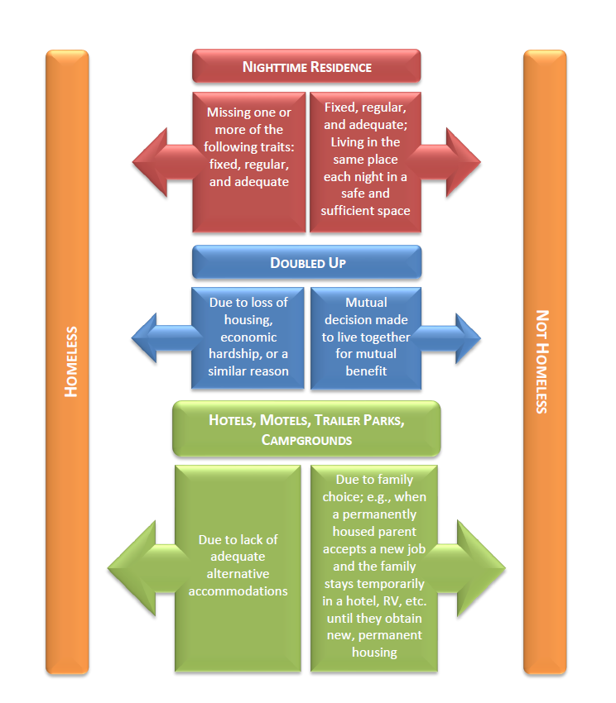
Flowchart for McKinney-Vento Eligibility
This flowchart is meant to aid you in the process of completing eligibility referrals to determine a student’s eligibility as homeless under the McKinney-Vento Act (42 U.S.C. 11431 et seq.), but it may not capture every housing situation.
For more information on making determinations, see the related issue brief from the National Center for Homeless Education at https://nche.ed.gov/wp-content/uploads/2018/10/det_elig.pdf.
Notes:
MV- established in 1987.

Slide 8
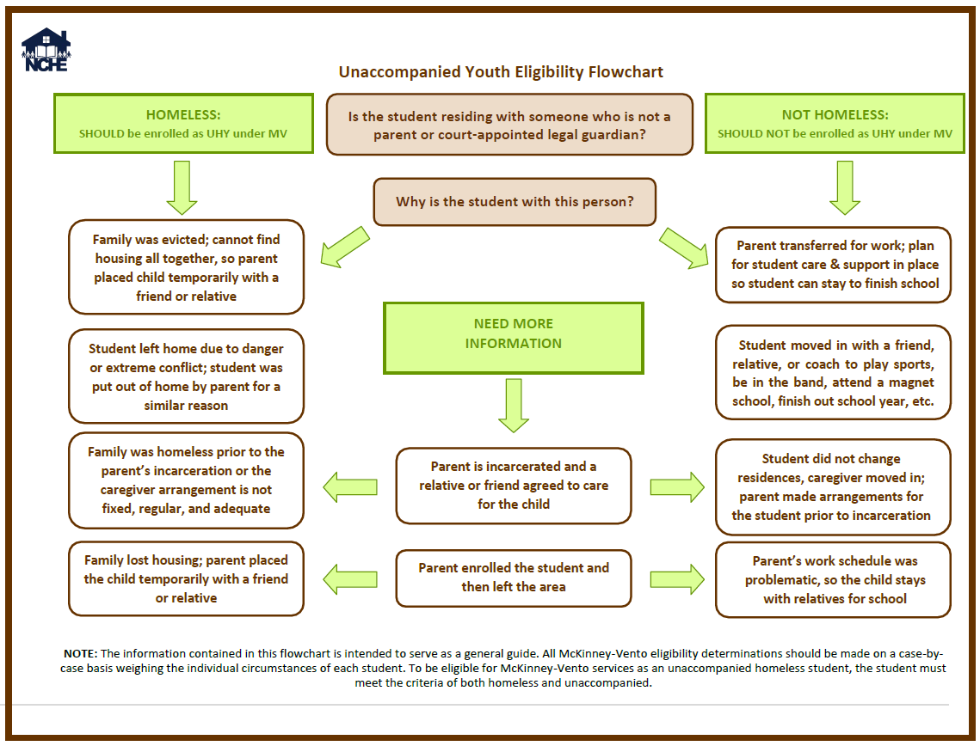
Unaccompanied Youth Flowchart
Notes:
MV- established in 1987.

Slide 9
Increasing the Identification of Students Experiencing Homelessness
Annual professional development provided to designated school site advocates, front office staff, nursing/clinical aid staff, nutrition services, WCSD bus drivers, teachers, administration, and local community agencies.
Increasing awareness in school buildings and commonly frequented establishments.
Continuity of the relationships between school staff and students.
Avoiding barriers to the identification and/or enrollment process.
Ensuring sibling identification.
Notes:
MV- established in 1987.

Slide 10
Knowing the Possible Signs of Homelessness
Characteristics that could be attributed to student experiencing homelessness:
Physical Signs:
Chronic hunger, hoarding of food
Poor grooming/hygiene
Fatigue and inability to concentrate
Chronic health problems
Emotional Signs:
Shame, low self-esteem
Extreme shyness, nervousness, or withdrawal
Anger, aggression
Marked change in behavior
Difficulty establishing relationships and building trust
Other Signs:
Lack of clean clothes and school supplies
Frequent absence, tardiness, change of schools
Consistently unprepared: no homework, books, papers requiring signature
Talk about staying with grandparents, other relatives, friends
Talk about taking care of parents or siblings
Notes:
MV- established in 1987.

Slide 11
WCSD Policy for Identifying Students Experiencing Homelessness
WCSD schools are required to appoint a designated advocate at each school site to work in collaboration with CIT Homeless Liaisons to identify, assess needs, and remove barriers of students who are experiencing homelessness.
School advocates coordinate with front office staff, clinical aids, kitchen staff, teachers, etc. to complete CIT Eligibility Referrals for students who meet the criteria of homelessness defined by McKinney-Vento.
School advocates verify information on the referrals with legal guardian/caregiver/unaccompanied youth and assess educational needs.
School advocates submit CIT Eligibility Referral to CIT office for eligibility determination by designated CIT Liaison based on the information verified on the referral by the school advocate.
School advocates maintain communication with the student/family experiencing homelessness to determine the ongoing supports and/or resources needed to ensure a successful educational experience.
Notes:
MV- established in 1987.

Slide 12
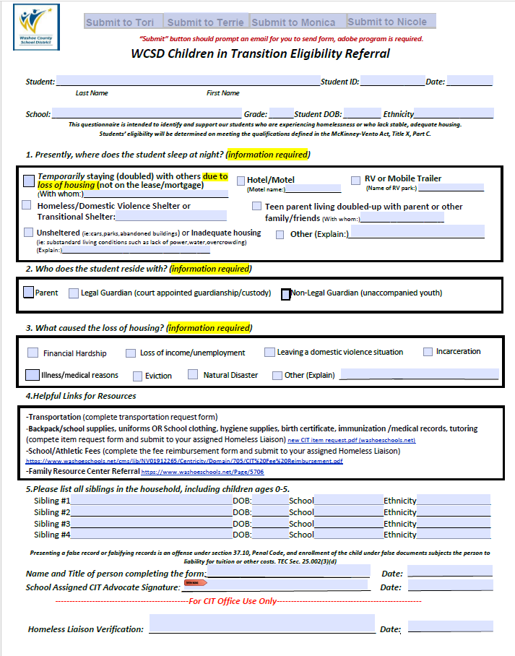
CIT Eligibility Referral Application
Notes:
MV- established in 1987.

Slide 13
Nutrition Services
School completes CIT Eligibility Referral Application.
Title I schools receive FRL for all students regardless of income or housing status
Send form immediately upon completion to CIT office.
Provide a copy of the CIT Eligibility Referral immediately to the school’s kitchen manager.
Student will begin receiving free school meals when CIT Eligibility Referral is received by the kitchen manager.
Daily Export sent to Nutrition Services.
Students identified as CIT in the daily export are updated in the Nutrition Services database “WEB smart” to receive free school meals for the entire school year.
Notes:
MV- established in 1987.

Slide 14
Barriers
Unable to meet enrollment requirements
Lack of Transportation
Basic needs not being met
Lack of adequate school supplies
Lack of appropriate school clothing/uniforms
Transiency
Unaware of the M-Vento definition of homelessness and qualifications
Unaware of educational rights and resources available
Fearful of child welfare involvement
Trauma caused by housing status
Notes:
MV- established in 1987.

Slide 15
Enrollment Rights
McKinney-Vento requires immediate enrollment in any public school that peers living in the same attendance area are eligible to attend even when lacking:
Proof of residency
Guardianship
Birth certificates, school records, or other documents
Medical records, including immunization records
Required dress code items, including uniforms
The term “enroll” and “enrollment” include attending classes and full participation in school activities.
Unaccompanied youth are required immediate enrollment without a parent or legal guardian present and are afforded the same enrollment rights as above.
Notes:
MV- established in 1987.

Slide 16
Enrollment Rights
Children experiencing homelessness have the right to enroll in:
The school of origin
The school that a child or youth attended when permanently housed, or
The school in which the child or youth was last enrolled.
Includes public preschools
Includes receiving schools
The local attendance area school (zoned school)
Any public school that non-homeless students who live in the attendance area in which the child or youth is living are eligible to attend.
Notes:
MV- established in 1987.

Slide 17
School of Origin
Presume remaining at school of origin is in the best interest of students’ social, emotional, and academic needs.
Eligible students have the right to attend the school of origin for the duration of homelessness. 42 U.S.C. § 11432(g)(3)(A)(i)(II)
Requires transportation to remain at school of origin when in the student’s best interest.
Why school of Origin?
Students who switch schools frequently score lower on standardized tests.
It takes youth 4-6 months to recover academically after changing schools.
It provides them with one constant in a life of variables.
Notes:
MV- established in 1987.

Slide 18
Transportation
Transportation department’s system is not able to accept handwritten requests. Please make sure to type into the document and email or submit electronically to: nestor.gonzalezroman@washoeschools.net
CIT has district vehicles to provide temporary transportation while a bus is routed, or other accommodations are being set up. Please email at nestor.gonzalezroman@washoeschools.net or call @ 775-353-6936 immediately to schedule temporary transportation with CIT district vehicles to avoid students missing school.
Students who have transportation written into their IEP must work with the student’s special education case manager AND CIT Transportation to arrange transportation.
Alternative transportation resources in lieu of a school bus being denied:
RTC bus passes
Mileage reimbursement
Notes:
MV- established in 1987.

Slide 19
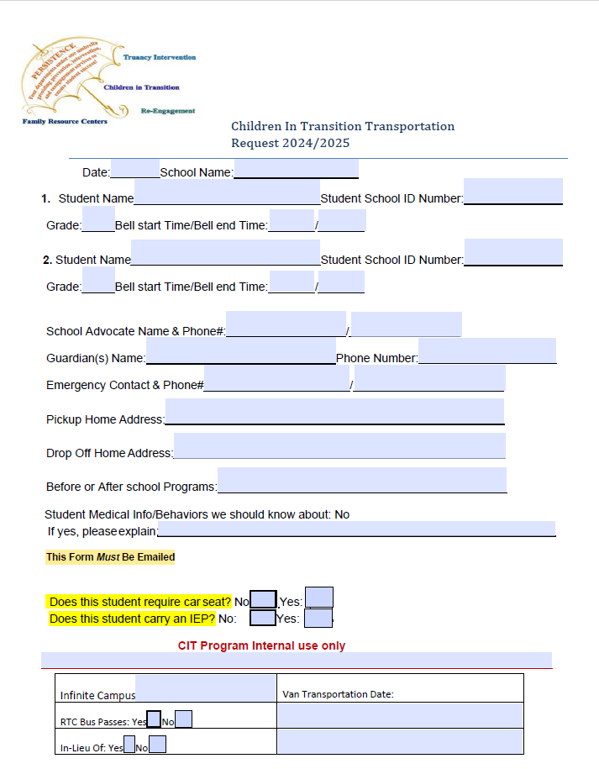
Transportation Request
Notes:
MV- established in 1987.

Slide 20
CIT Resources
School meals
Hygiene packets
School clothing/Uniforms
Transportation Resources
School fees
Birth certificates, immunizations and/or records
Athletic fees and equipment required to participate
School supplies
Field trip cost support-case by case
Tutoring
Cap and Gowns

Slide 21
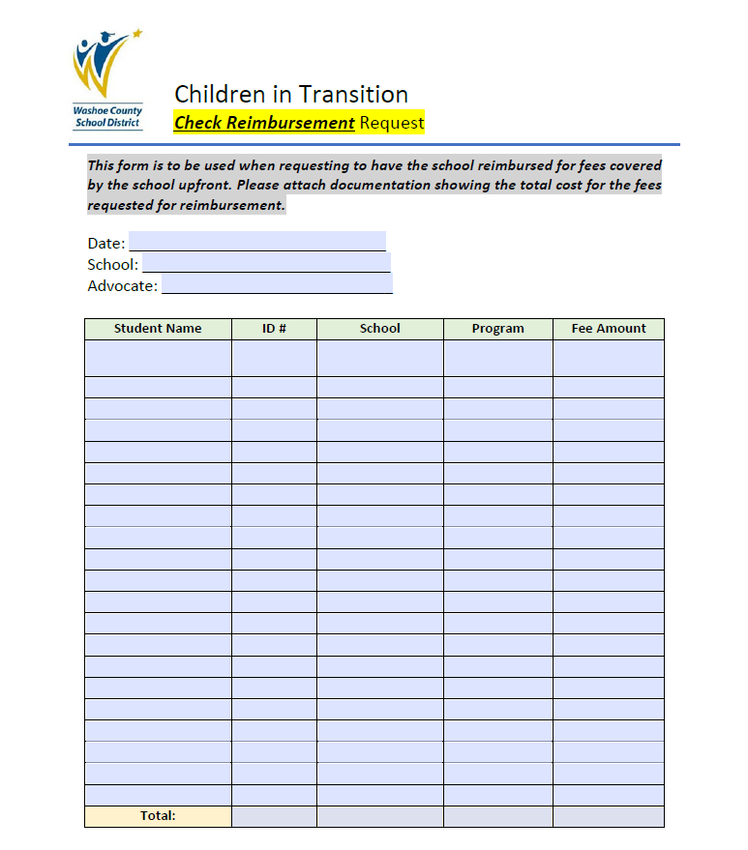
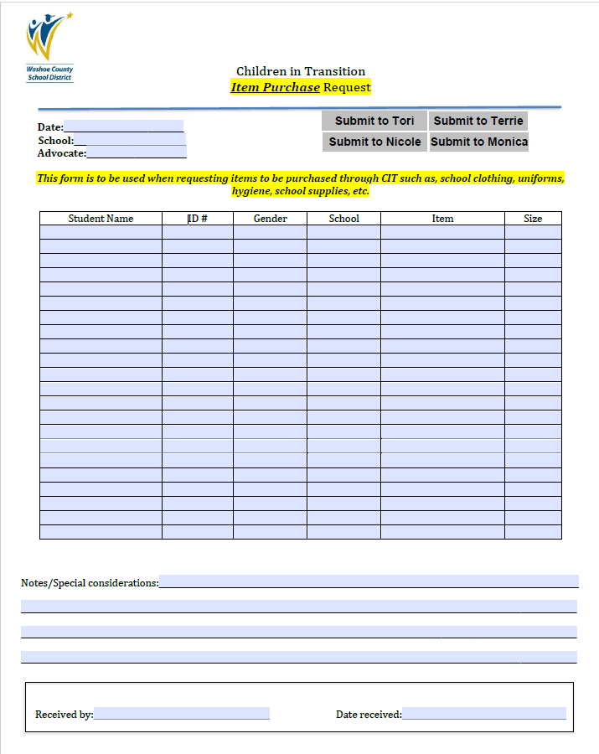
Item Request and Check Reimbursement Requests
Notes:
MV- established in 1987.

